Slide 2


Email Etiquettes

Slide 3
Agenda
Parts of an email
Format and Structure of an email
Delivering the message appropriately through an email

Slide 4
Importance of Email Etiquette
Business writing is an important skill that you must possess.
It helps you follow the global norms while writing emails to your internal and external stakeholders.
Communicating clearly while writing, helps you create a positive impression.

Slide 5
6 Parts of an email
Sender: From
Receiver: TO, CC
Subject
Salutation
Body of the email
Signature

Slide 6
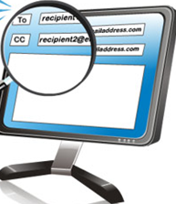
Selecting Your Audience
Ensure that you are writing to the right person
To: for people who need to take an action
CC: for people who need to be in the loop, however may not actually take an action
BCC: to be avoided at all times
Make sure only necessary Distribution Lists are included.

Slide 7
Anticipating Three Typical Business Audiences : WHO
Other teams
Customers
Managers
Be courteous
Be concise
Come to the point directly
Keep your manager in loop
Treat them equally
Remember your Customer service skills
Be courteous and show respect
Try to set a positive tone
Have some degree of formality, depending on the type of customer
State what can be done or options or work arounds available
Always show respect, however you don’t have to be very formal
Remember that your manager receives many mails
Come to the point quickly
Give enough background
Remember you may have to follow up

Slide 8

Subject Line
Should have minimum words
Should be grammatically accurate
Never be just : FYI
Always have TT reference wherever required
Give the reader an accurate picture of what the mail is about
If the Email is complicated, try writing the subject line last this way your subject line and the contents of the mail match

Slide 9

Salutation
Always start with a salutation.
Personalize the email by using the correct salutation and the customer’s name
Acceptable Salutations:
Hi Sadhna,
Dear Mr. Joshi, ( only for extremely formal mails)
Dear Rajesh,
Hi Team (Acceptable for generic not directive information)
Unacceptable Salutations:
Hey Kev
Or no salutation at all

Slide 10

Body of the email
All your emails should have minimum 3 parts
Opening
Body
Closing

Slide 11
Opening of the Email
The opening line of your email should give the reader
The reason you are writing
Reference of a previous mail, you are responding to
Good Opening Lines
With reference to your mail dated 8th June, I ...
I am writing to enquire about ...
This is regarding your email…
With reference to the mail below on TT……
This is with reference to your query about….
With reference to our discussion….
This is to summarize the details of our meeting, held on 1st January….

Slide 12
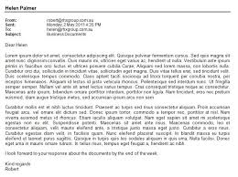
Paragraphs
Paragraphs must have unity- contents of the paragraph should concern one topic or idea
Sentences should be under 20 words- 17 is the average.
Long sentences hinder readability of e-mails. Leave out unnecessary details.
Short sentences are very effective, but make sure you don’t leave them incomplete.

Slide 13
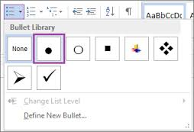
Bullets and numbering
Use bullets and points to explain your views effectively
Use numbers or letters to indicate sequence, importance or instructions
Use numbering when appropriate
Use letters if the points to be discussed are up to (e)
Try a combination of Numeric and letters for complex issues
Make bullet points consistent
Avoid making bullet points too long
Be sure bullet points are related.

Slide 14
Closing of the Email
The closing line of your email should
Give future action plan
Clearly state what is expected from the reader
Good Closing Lines
If you require any further information, feel free to contact me/us.
I look forward to your reply/ hearing from you.
Please advise as necessary.
We look forward to your cooperation
Looking forward to your support
We appreciate your patience.
Once again, I apologise for any inconvenience.
I would appreciate your immediate attention to this matter.
Please let me know if you need any clarifications/ further details
Please confirm at the earliest.

Slide 15
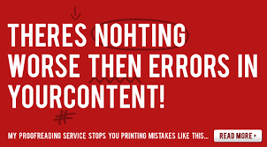
The Importance of Proofreading
Read your mail at least once before hitting send
Use Grammar and Spell Check
Look for spelling and grammatical errors yourself
See if there is room for misinterpretation/confusion

Slide 16
10 Tips for Formatting the Email
Align all the content to the left
Use professional fonts –Arial ,Times New Roman , Calibri etc.
Use black or blue font a plain white background
Highlight with bold ,Italics or underline
All CAPS can make you seem like your shouting
Use numbers or letters to list or indicate a sequence
Use bullets to make it easy to read
Use tables or pictures
Keep the email one screen length
One line paragraphs are acceptable in emails
Use Vodafone font

Slide 17
Let’s Practice
Write a mail to the customer who wants to book a TT for link down but has not provided any of the details you require.
Write a mail to a customer stating that you have not observed any problem in Vodafone’s network and the link is working fine.
Write a mail to your manager asking him to approve leaves as your sister is getting married
Write a mail to the training team, requesting them to conduct XYZ training as it will enhance your skills.

Slide 18
Write a reply
Dear Vodafone,
Please book a ticket. My link is down since 20 minutes. Circuit id xxxxxxxxxxx.
Please solve asap.
Regards,
Vikaskumar Jha

Slide 19
Write a reply
Dear Vodafone,
Please give an update on ticket EN_IM_20170118_123456.
Regards,
Siddharth

Slide 20
Let’s Practice- rewrite this mail
Dear Customer,
Apologies for the delay.
Team is still working on the restoration as it getting delayed due to heavy rain. Extended ETR is till 1.00 IST 21st September.
We will keep you posted further.
Thanks & Regards,
Earl Grey
ABCD Desk
Vodafone
India

Slide 21
Thank you !

